Slide 1

Autistic Spectrum Disorder Prediction Based on human gut microbiome
By Chris Chen

Slide 2
Background—Dataset
This is a dataset about human gut microbiome of healthy vs Autistic Spectrum Disorder (ASD) patients.
n=254, 143 ASD subjects and 111 healthy subjects.
Response is ASD or not (artificially constructed), encoded as 0 (no) or 1 (yes).
Covariates are Operational Taxonomic Unit (OTU) abundance, encoded numerically. The OTU information is obtained using High Throughput Sequencing. We have 1322 OTUs in total.
The corresponding taxa to the OTUs are also provided.

Slide 3
Background—Collection
All the subjects are Chinese children aged from 2 to 13
Recruited from May 2016 to Aug 2017 from hospitals and kindergartens
The children with ASD in this study were diagnosed according to DSM-5
Feces were collected at hospital or home according to instruction and delivered immediately at low temperatures
The frozen feces were shipped using dry ice overnight to Nanjing Medical University and were analyzed there

Slide 4
Scientific questions
Can we predict the subject’s ASD outcome based on his/her OTU information? Efficient prediction could potentially save a lot of medical resources
Which OTU(s) contribute the most to the outcome? They could bring insight into future ASD treatment / intervention
Which method(s) have the best performance and generalization potential?

Slide 5
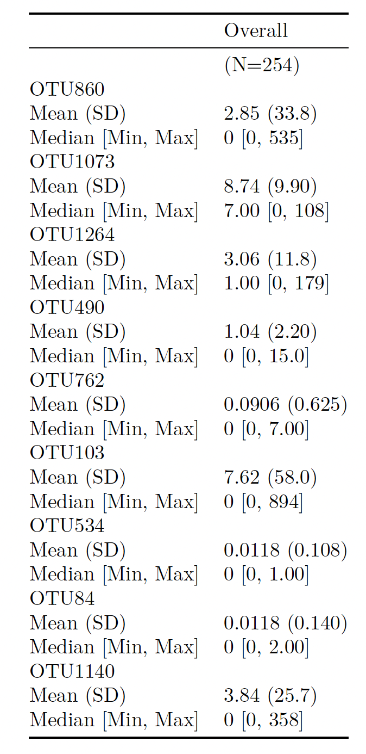
Overview—Descriptive Statistics

Slide 6
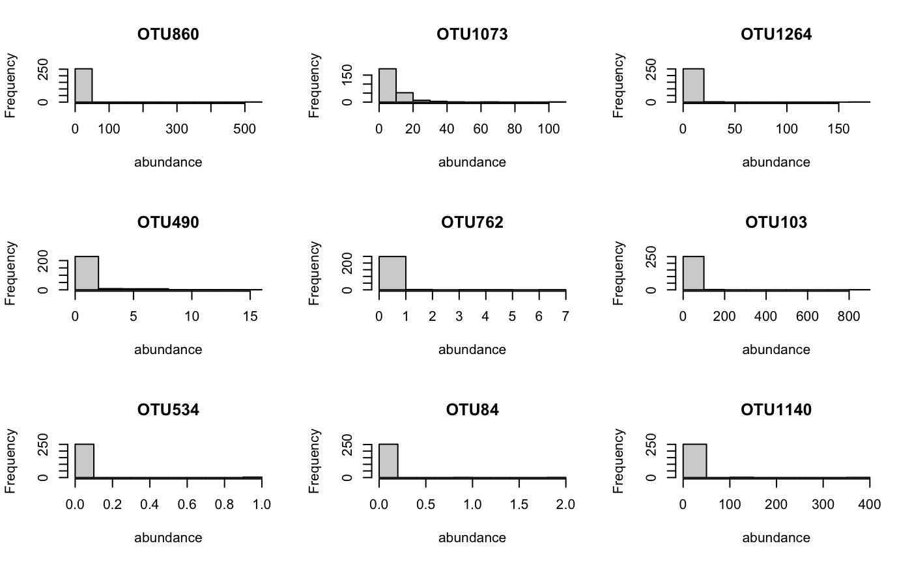
OverView—Distributions (Micro)

Slide 7
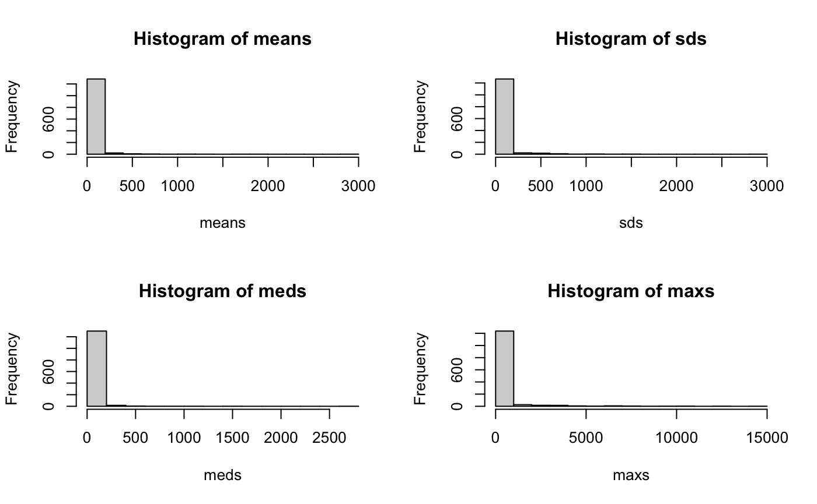
OVervieW—Distributions (Macro)

Slide 8
Method—Workflow
Machine learning classification models using RF, Gradient Boost, XGBoost, and SVM were constructed to predict the outcome (ASD or healthy) of the subject based on his/her OTU information
Feature rescaling was done to improve the performance of SVM due to the nature of SVM
Test error rate, precision, recall, and F-1 score were calculated and used to evaluate and compare the models
Feature importance were calculated and ranked
Models were re-fitted using the selected most important features (numbers vary) and the convergence behaviors were studied
The model that has the best performance was selected

Slide 9
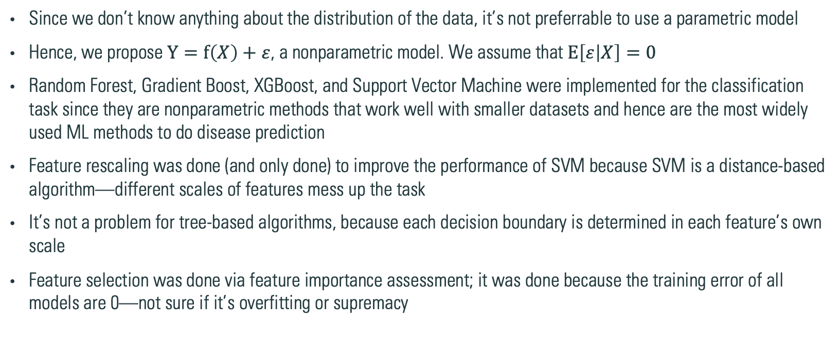
Method—Logic explained
Since we don’t know anything about the distribution of the data, it’s not preferrable to use a parametric model
Hence, we propose $Y=f\left(X\right)+ε$, a nonparametric model. We assume that $E\left[ε | X\right]=0$
Random Forest, Gradient Boost, XGBoost, and Support Vector Machine were implemented for the classification task since they are nonparametric methods that work well with smaller datasets and hence are the most widely used ML methods to do disease prediction
Feature rescaling was done (and only done) to improve the performance of SVM because SVM is a distance-based algorithm—different scales of features mess up the task
It’s not a problem for tree-based algorithms, because each decision boundary is determined in each feature’s own scale
Feature selection was done via feature importance assessment; it was done because the training error of all models are 0—not sure if it’s overfitting or supremacy

Slide 10
Method—Convergence
What do I mean by convergence?
Basically, a measure of generalization potential
Motivated by answering the question: is it overfitting or supremacy?
How do I know that? I select different number of features, varying from 20 to 1000 and observe the training errors and test errors. If training error is always 0 AND the test error cannot be lower than the full model, then it is supremacy
If this “AND” condition is not satisfied, then it’s overfitting
How to select the features?
Select the 10, 20, …, 500 most important features (MIF) using each method from the full model → construct a MIF consensus pool (size range from 27 to 996) → fit the model on these features, calculate the train and test error rate → see if there’s any convergence trend and see if the “AND” condition is satisfied

Slide 11
Results—Model PerFoRmance
Method | Train Error Rate | Test Error Rate | Precision | Recall | F1-Score
Random Forest | 0.00 | 0.06 | 0.91 | 1.00 | 0.95
Gradient Boost | 0.00 | 0.08 | 0.90 | 0.97 | 0.93
XGBoost | 0.00 | 0.06 | 0.91 | 1.00 | 0.95
SVM | 0.00 | 0.24 | 0.84 | 0.72 | 0.78
SVM Reconstructed | 0.00 | 0.06 | 0.93 | 0.97 | 0.95

Slide 12
Results—feature Importance
Model | Most Important OTUs (Decreasing Importance)
Random Forest | 625, 1225, 976, 1053, 910, 1301, 970, 390, 628, 793
Gradient Boost | 625, 1301, 970, 976, 964, 53, 222, 390, 840, 400
XGBoost | 625, 1301, 976, 390, 1279, 41, 1087, 1225, 75, 222
SVM | 1020, 713, 1157, 893, 167, 814, 680, 20, 94, 628

Slide 13
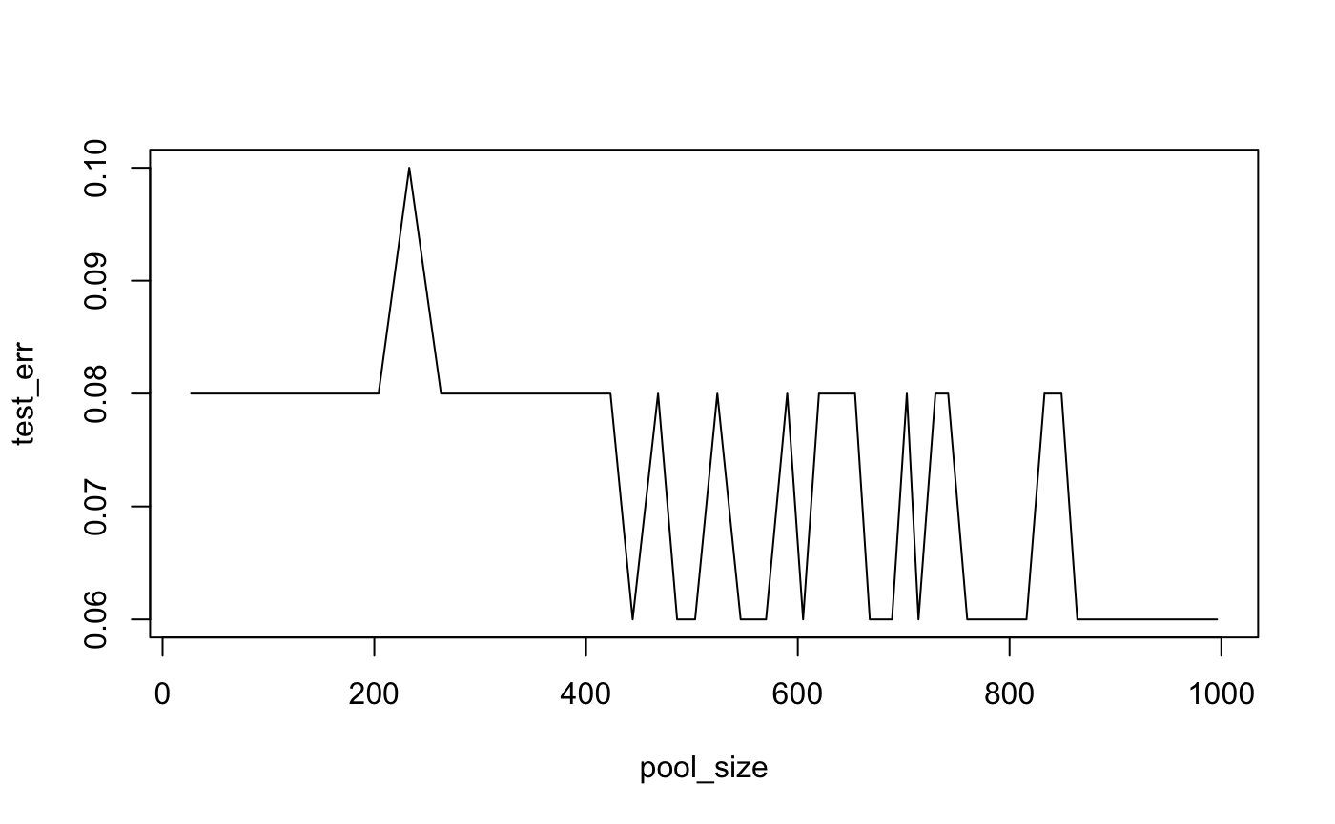
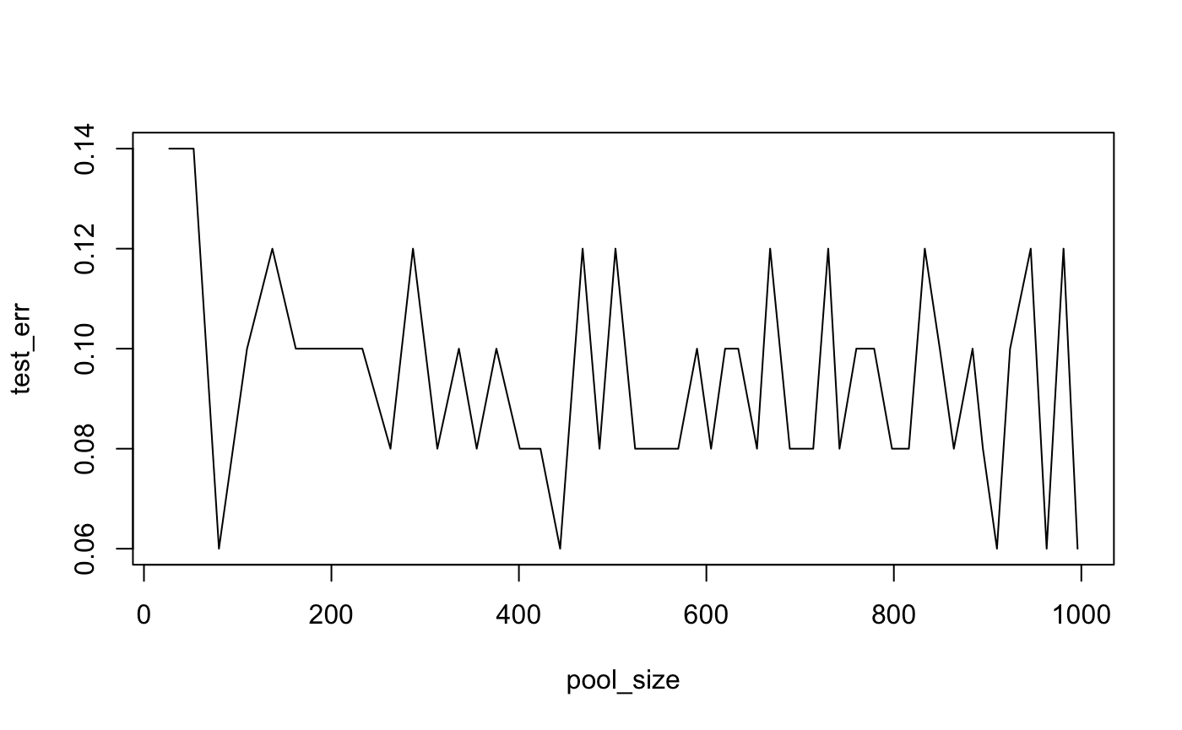
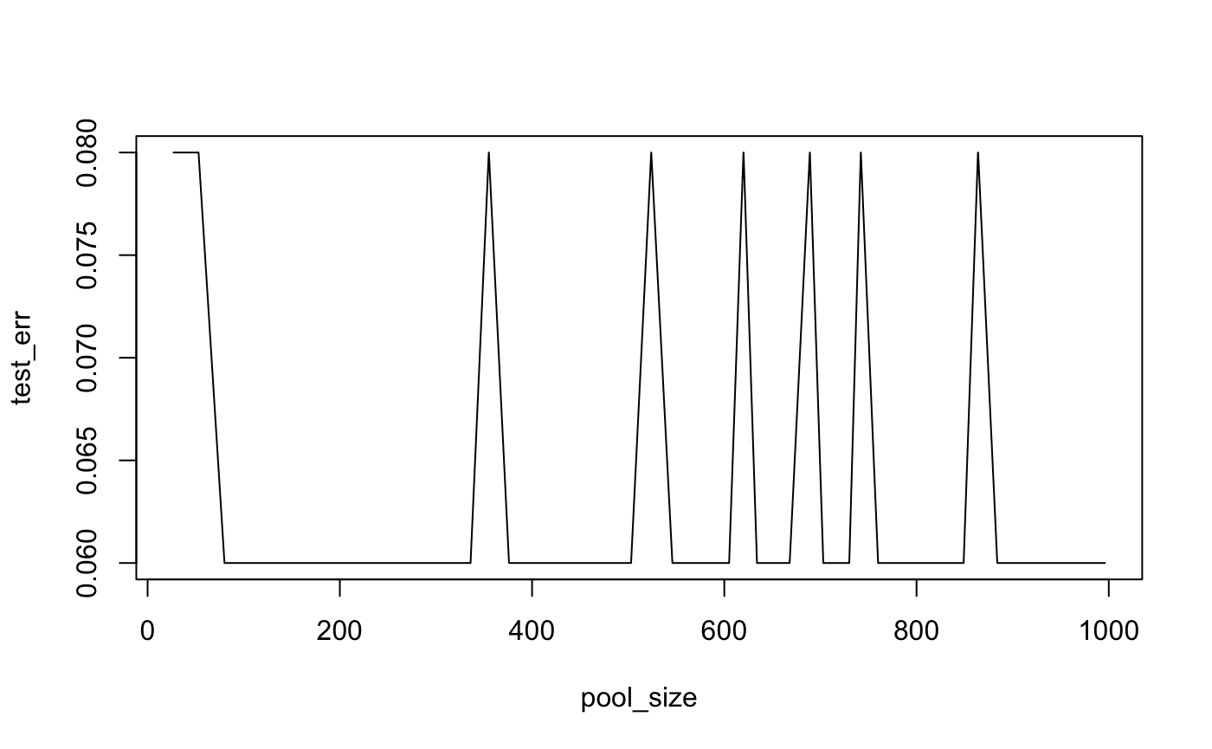
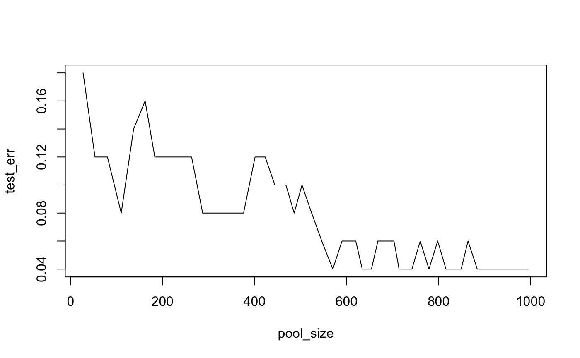
Results—Convergence
Random Forest
Gradient Boost
Xtreme Gradient Boost
Support Vector Machine

Slide 14
Conclusion—Answering Qs
Based on the plain evaluation metrics, RF, XGB, and SVM perform equally good; but SVM and GB overfits while others achieve supremacy using full data
XGB is very slow though (3-5 times the run time of RF)
The most important features: 3 models agreed that OTU625, OTU976, OTU1301, OTU390 are among the 10 most important OTUs; 2 models agreed that OTU1225, OTU970, OTU628, OTU222 are among the 10 most important OTUs (names too long, not provided on this page)
Based on the convergence, i.e. generalization potential, SVM is the best: test error can go down to 0.04

Slide 15
Conclusion—Discussion
Feature extraction is not recommended (tried PCA, ICA, and t-SNE)
The largest problem: interpretability—Since one of our goals is to identify the most important/influential OTUs, it's not desirable to combine the OTUs to form new entities
Besides this problem, the result produced is pretty bad—the accuracy is around 0.6 for all models
Tree-based algorithms perform similarly—they have close metrics and similar feature importance rankings
Distance-based algorithm gives very different feature importance ranking—likely because the quantity used to judge “importance” is different—weights for SVM, mean decreased Gini Index for Trees
Tree-based algorithms exhibit an “alternating test error rate” behavior—because the final classification on one or few points alternates as we have more and more information

Slide 16
Conclusion—Future Direction
Parameter tuning could be done using k-fold cross validation—not done for all models yet because it’s too time consuming and because we tried one on RF—the result given is no different than that of the untuned model
Deep Learning models could not be implemented due to R problems—Keras (for MLPNN and CNN), Ruta (for Autoencoders and LSTM) always lead to abortion of R sessions; can try on better computers
Dataset could be larger and could include more OTUs
Better interpretation of the results—not only on “OTU level”, but can go deeper onto microbiome level from a biological perspective

Slide 17
Related Microbiomes
OTU222 | d__Bacteria;_k__norank;_p__Firmicutes;_c__Clostridia;_o__Clostridiales;_f__Ruminococcaceae;_g__Intestinimonas;_s__Intestinimonas_butyriciproducens
OTU390 | d__Bacteria;_k__norank;_p__Bacteroidetes;_c__Bacteroidia;_o__Bacteroidales;_f__Porphyromonadaceae;_g__Barnesiella;_s__uncultured_organism_g__Barnesiella
OTU625 | d__Bacteria;_k__norank;_p__Bacteroidetes;_c__Bacteroidia;_o__Bacteroidales;_f__Prevotellaceae;_g__Prevotella_2;_s__uncultured_organism_g__Prevotella_2
OTU628 | d__Bacteria;_k__norank;_p__Firmicutes;_c__Clostridia;_o__Clostridiales;_f__Ruminococcaceae;_g__Ruminiclostridium_6;_s__[Eubacterium]_siraeum_DSM_15702
OTU970 | d__Bacteria;_k__norank;_p__Firmicutes;_c__Clostridia;_o__Clostridiales;_f__Ruminococcaceae;_g__Ruminiclostridium_6;_s__unclassified_g__Ruminiclostridium_6
OTU976 | d__Bacteria;_k__norank;_p__Firmicutes;_c__Clostridia;_o__Clostridiales;_f__Ruminococcaceae;_g__Ruminococcaceae_UCG-014;_s__unclassified_g__Ruminococcaceae_UCG-014
OTU1225 | d__Bacteria;_k__norank;_p__Firmicutes;_c__Clostridia;_o__Clostridiales;_f__Lachnospiraceae;_g__Lachnoclostridium;_s__uncultured_Clostridiales_bacterium_g__Lachnoclostridium
OTU1301 | d__Bacteria;_k__norank;_p__Firmicutes;_c__Negativicutes;_o__Selenomonadales;_f__Veillonellaceae;_g__Megasphaera;_s__uncultured_bacterium_g__Megasphaera

Slide 18
Data Source
Dataset: https://www.kaggle.com/datasets/antaresnyc/human-gut-microbiome-with-asd
Original publication: https://www.tandfonline.com/doi/full/10.1080/19490976.2020.1747329

